Slide 1
Using Machine Learning to Predict March Madness
Sarick Shah

Slide 2
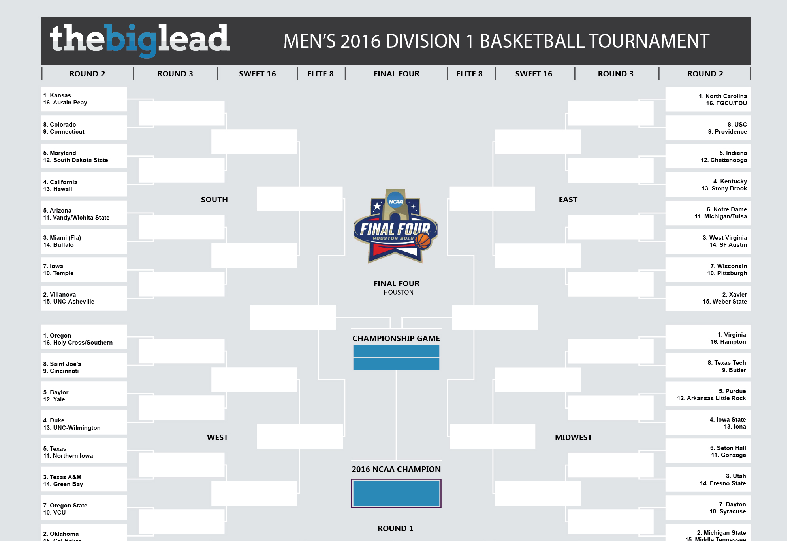
What is March Madness?
68 teams
Single game elimination
1 in 610,543,269 chance of filling out the whole bracket correctly!

Slide 3
Data
Kaggle provided raw statistics starting from 2003.
Elo Ranking
Only looked at the last six games of each season
After every game, the winning player takes points from the losing one
Highly ranked team takes few points from weak opponent.
Upsets lead to high point transfers.
Accounts for autocorrelation with a “K” factor (doesn’t overreact to new results)
Accounts for home court advantage
Feature
Elo Rating
Score
Field Goal Percentages
Field Goal Attempts
3 Point Field Goal Attempts
3 Point %
Free Throw %
Offensive Rebounds
Defensive Rebounds
Assists
Turnovers
Steals
Blocks
Personal Fouls

Slide 4
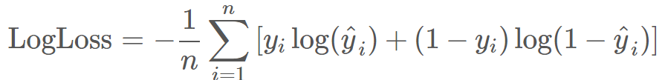
Performance Measure
Log Loss
Smaller is better
Punishes predictions that are confident and wrong
Submitted prediction probability for all possible matchups (2278)
Kaggle median score was .55872

Slide 5
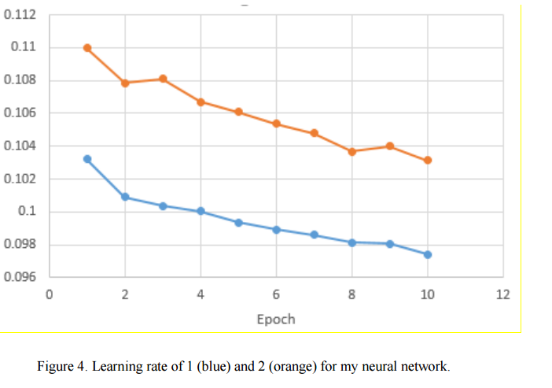

Models
Logistic Regression
Minimize logistic function instead of linear one like SSE
Class probabilities depend on distance from boundary
Neural Network (FAIL)
Trained across 10 epochs
Didn’t allow full convergence (training error was still going down)
0.96459 Log Loss?!?!?!?!?!

Slide 6
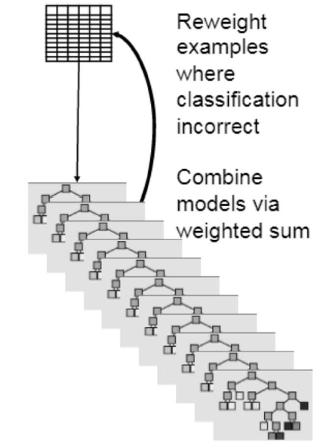
Boosting Ensemble
All data points are equally weighted initially
Increase accuracy by reweighting examples misclassified by previous weak learner
Can lead to overfitting

Slide 7
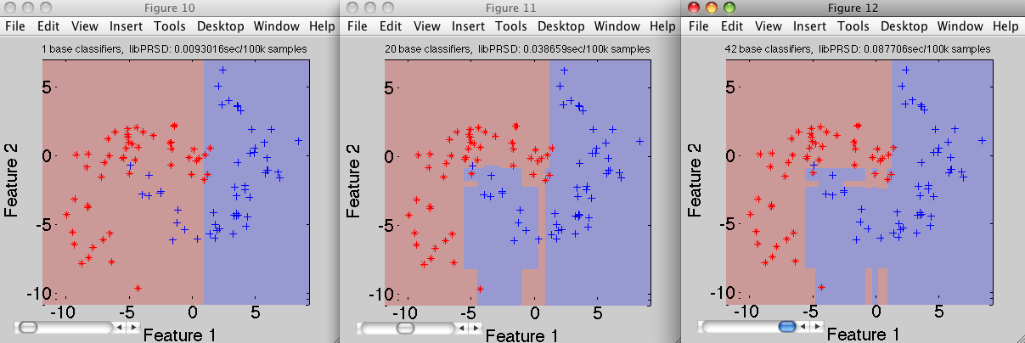
Effect of Increasing Learners on Decision Boundary

Slide 8
Results
Classifier | Test Set Log Loss
Kaggle Median | 0.55872
Previous Year Winner | 0.54107
Logistic Regression | 0.55220
Boosted Logistic Regression | 0.55147

Slide 9

Changes for this year
Use more aggregate statistics like eFG%, TS%, etc.
Feature Selection
Try Random Forests
Instead of dropping earlier games, maybe weight them less but still account for them.
Get the NN to actually work…

Slide 10
Resources
http://fivethirtyeight.com/features/how-we-calculate-nba-elo-ratings/
http://rasbt.github.io/mlxtend/user_guide/classifier/LogisticRegression/
Lopez, Michael J., and Gregory Matthews. "Building an NCAA mens basketball predictive model and quantifying its success." 1412.0248(2014).
Silver, Nate. “How FivethirtyEight is forecasting the 2016 NCAA tournament”http://fivethirtyeight.com/features/how-fivethirtyeight-is-forecasting-the-2016-ncaatournament/ (2016).

Slide 11
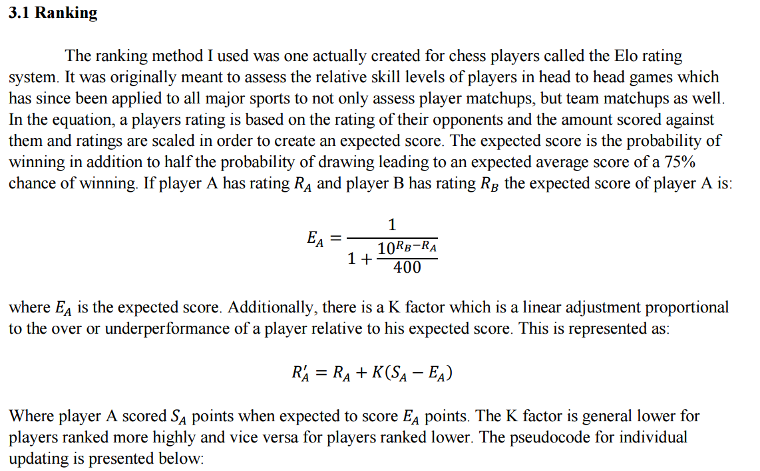
Elo Suppl

